Slide 1
CISP 310 Assembly Language Programming for Microcomputers
Fall 2016
Professor Suha Aljuboori
Lecture1

Slide 2
Chapter One Representing Data in Computer

Slide 3
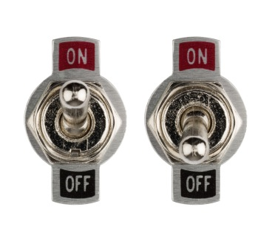
Data Representation
Data refers to the symbols that represent people, events, things, and ideas. Data can be a name, a number, the colors in a photograph, or the notes in a musical composition.
Numeric or Character Data
Data representation refers to the form in which data is stored, processed, and transmitted.
Binary digit (Bit) 0,1

Slide 4
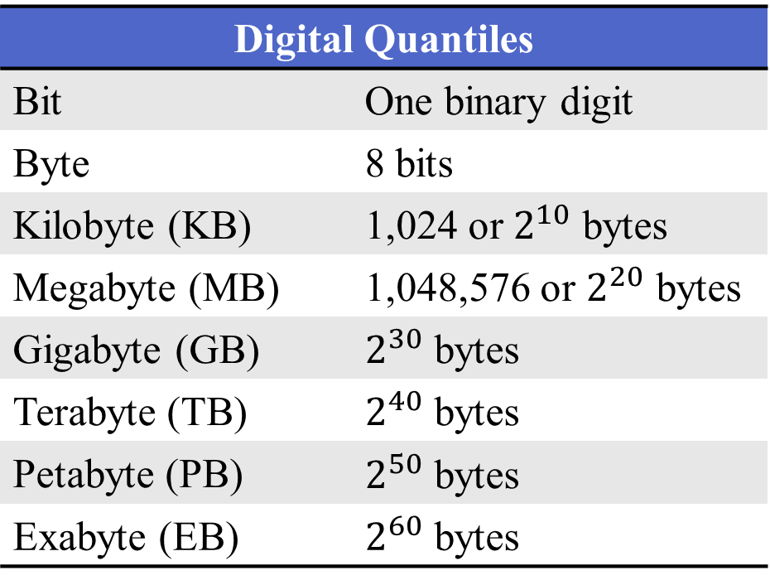
Memory Conventions

Slide 5
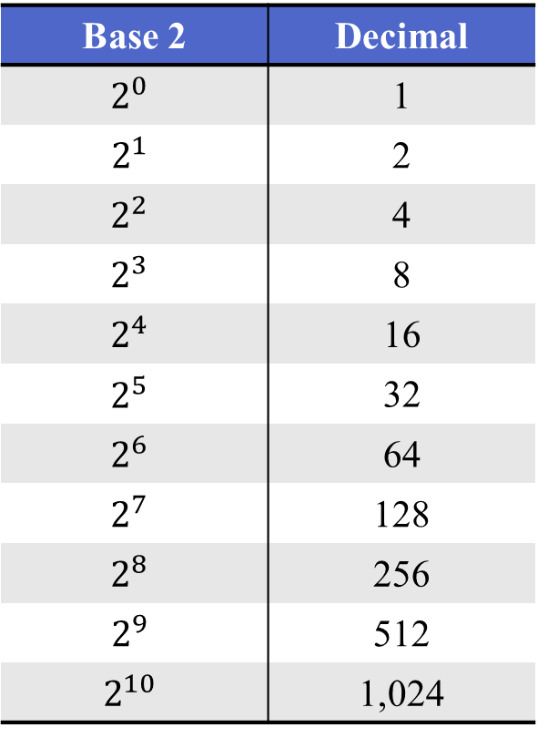
Why Kilo=1024 not 1000
It’s all because binary numbers are of Base 2
Base 2 | Decimal
$$2^{0}$$ | 1
$$2^{1}$$ | 2
$$2^{2}$$ | 4
$$2^{3}$$ | 8
$$2^{4}$$ | 16
$$2^{5}$$ | 32
$$2^{6}$$ | 64
$$2^{7}$$ | 128
$$2^{8}$$ | 256
$$2^{9}$$ | 512
$$2^{10}$$ | 1,024

Slide 6
Numbering Systems
Base 2: Binary
Base 8: Octal
Base 10: Decimal
Base 16: Hexadecimal

Slide 7
Binary
Numbers representing using 0 , 1
It’s the decimal system except that the positions (right to left) are:
1’s, 2’s, 4’s, 8’s, 16’s (and higher powers of 2)
instead of 1’s, 10’s, 100’s, 1000’s, 10000’s (powers of 10)
Example:
The Binary number 0110 = 6 in Decimal

Slide 8
Conversion
Decimal to Binary
Division Method
Subtraction Method
Binary to Decimal
Multiplication Method
Addition Method
Both
Easy Method

Slide 9
Division Method
35 ÷ 2 = 17 Remainder 1
17 ÷ 2 = 8 Remainder 1
8 ÷ 2 = 4 Remainder 0
4 ÷ 2 = 2 Remainder 0
2 ÷ 2 = 1 Remainder 0
1 ÷ 2 = 0 Remainder 1
Bottom Up
100011 = 35

Slide 10
Subtraction Method
Convert 227 to binary:
2^10 | 2^9 | 2^8 | 2^7 | 2^6 | 2^5 | 2^4 | 2^3 | 2^2 | 2^1 | 2^0
1024 | 512 | 256 | 128 | 64 | 32 | 16 | 8 | 4 | 2 | 1
0

Slide 11
Subtraction Method
Convert 227 to binary:
2^10 | 2^9 | 2^8 | 2^7 | 2^6 | 2^5 | 2^4 | 2^3 | 2^2 | 2^1 | 2^0
1024 | 512 | 256 | 128 | 64 | 32 | 16 | 8 | 4 | 2 | 1
0 | 0

Slide 12
Subtraction Method
Convert 227 to binary:
2^10 | 2^9 | 2^8 | 2^7 | 2^6 | 2^5 | 2^4 | 2^3 | 2^2 | 2^1 | 2^0
1024 | 512 | 256 | 128 | 64 | 32 | 16 | 8 | 4 | 2 | 1
0 | 0 | 0

Slide 13
Subtraction Method
Convert 227 to binary:
2^10 | 2^9 | 2^8 | 2^7 | 2^6 | 2^5 | 2^4 | 2^3 | 2^2 | 2^1 | 2^0
1024 | 512 | 256 | 128 | 64 | 32 | 16 | 8 | 4 | 2 | 1
0 | 0 | 0 | 1
227 - 128 = 99

Slide 14
Subtraction Method
Convert 227 to binary:
2^10 | 2^9 | 2^8 | 2^7 | 2^6 | 2^5 | 2^4 | 2^3 | 2^2 | 2^1 | 2^0
1024 | 512 | 256 | 128 | 64 | 32 | 16 | 8 | 4 | 2 | 1
0 | 0 | 0 | 1 | 1
227 - 128 = 99
99 – 64 = 35

Slide 15
Subtraction Method
Convert 227 to binary:
2^10 | 2^9 | 2^8 | 2^7 | 2^6 | 2^5 | 2^4 | 2^3 | 2^2 | 2^1 | 2^0
1024 | 512 | 256 | 128 | 64 | 32 | 16 | 8 | 4 | 2 | 1
0 | 0 | 0 | 1 | 1 | 1
227 - 128 = 99
99 – 64 = 35
35 - 32 = 3

Slide 16
Subtraction Method
Convert 227 to binary:
2^10 | 2^9 | 2^8 | 2^7 | 2^6 | 2^5 | 2^4 | 2^3 | 2^2 | 2^1 | 2^0
1024 | 512 | 256 | 128 | 64 | 32 | 16 | 8 | 4 | 2 | 1
0 | 0 | 0 | 1 | 1 | 1 | 0
227 - 128 = 99
99 – 64 = 35
35 - 32 = 3

Slide 17
Subtraction Method
Convert 227 to binary:
2^10 | 2^9 | 2^8 | 2^7 | 2^6 | 2^5 | 2^4 | 2^3 | 2^2 | 2^1 | 2^0
1024 | 512 | 256 | 128 | 64 | 32 | 16 | 8 | 4 | 2 | 1
0 | 0 | 0 | 1 | 1 | 1 | 0 | 0
227 - 128 = 99
99 – 64 = 35
35 - 32 = 3

Slide 18
Subtraction Method
Convert 227 to binary:
2^10 | 2^9 | 2^8 | 2^7 | 2^6 | 2^5 | 2^4 | 2^3 | 2^2 | 2^1 | 2^0
1024 | 512 | 256 | 128 | 64 | 32 | 16 | 8 | 4 | 2 | 1
0 | 0 | 0 | 1 | 1 | 1 | 0 | 0 | 0
227 - 128 = 99
99 – 64 = 35
35 - 32 = 3

Slide 19
Subtraction Method
Convert 227 to binary:
2^10 | 2^9 | 2^8 | 2^7 | 2^6 | 2^5 | 2^4 | 2^3 | 2^2 | 2^1 | 2^0
1024 | 512 | 256 | 128 | 64 | 32 | 16 | 8 | 4 | 2 | 1
0 | 0 | 0 | 1 | 1 | 1 | 0 | 0 | 0 | 1
227 - 128 = 99
99 – 64 = 35
35 - 32 = 3
3 - 2 = 1

Slide 20
Subtraction Method
Convert 227 to binary:
2^10 | 2^9 | 2^8 | 2^7 | 2^6 | 2^5 | 2^4 | 2^3 | 2^2 | 2^1 | 2^0
1024 | 512 | 256 | 128 | 64 | 32 | 16 | 8 | 4 | 2 | 1
0 | 0 | 0 | 1 | 1 | 1 | 0 | 0 | 0 | 1 | 1
227 - 128 = 99
99 – 64 = 35
35 - 32 = 3
3 - 2 = 1
1 - 1 = 0

Slide 21
Subtraction Method
Convert 227 to binary:
2^10 | 2^9 | 2^8 | 2^7 | 2^6 | 2^5 | 2^4 | 2^3 | 2^2 | 2^1 | 2^0
1024 | 512 | 256 | 128 | 64 | 32 | 16 | 8 | 4 | 2 | 1
0 | 0 | 0 | 1 | 1 | 1 | 0 | 0 | 0 | 1 | 1
227 - 128 = 99
99 – 64 = 35
35 - 32 = 3
3 - 2 = 1
1 - 1 = 0
227 = 1110 0011

Slide 22
Multiplication Method
Repeated multiplication by 2
Convert 1100 to decimal:
1100_{b} = 12_{d}
0 * 2 + 1 = 1
1 * 2 + 1 = 3
3 * 2 + 0 = 6
6 * 2 + 0 = 12
Notes:
This is the best long-hand method. You can use this to convert to any base, and all you have to remember in your head is the running tally.

Slide 23
Addition Method
Convert 0100 0001 0011 to decimal:
2^10 | 2^9 | 2^8 | 2^7 | 2^6 | 2^5 | 2^4 | 2^3 | 2^2 | 2^1 | 2^0
1024 | 512 | 256 | 128 | 64 | 32 | 16 | 8 | 4 | 2 | 1
1 | 0 | 0 | 0 | 0 | 0 | 1 | 0 | 0 | 1 | 1
1024 + 0 + 0 + 0 + 0 + 0 + 16 + 0 + 0 + 2 + 1 = 1043
0100 0001 0011_{b} = 1043_{d}

Slide 24
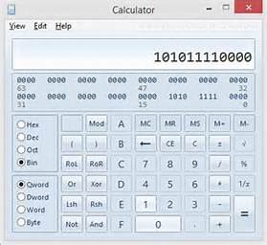
Easy Method

Slide 25
Octal
In Octal, a binary number is divided up into groups of only 3 bits
Each group or set of bits having a distinct value of between 000 (0) and 111 ( 4+2+1 = 7 ).
Counting in Octal
1 2 3 4 5 6 7 10 11 12 13 14 15 17 20

Slide 26
Octal Decimal Binary
Octal | 0 | 1 | 2 | 3 | 4 | 5 | 6 | 7 | 10 | 11 | 12
Decimal | 0 | 1 | 2 | 3 | 4 | 5 | 6 | 7 | 8 | 9 | 10
Binary | 000 | 001 | 010 | 011 | 100 | 101 | 110 | 111 | 001 000 | 001 001 | 001

Slide 27
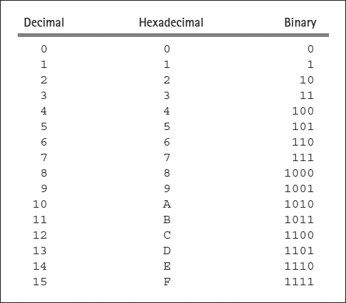
Hexadecimal
The hexadecimal (base 16) number system represents numbers using about one fourth as many digits as the binary system.

Slide 28
Counting with hexadecimal
0 1 2 3 4 5 6 7 8 9 A B C D E F 10
11 12 13 14 15 16 17 18 19 1A 1B 1C 1D 1E 1F 20

Slide 29
Conversion: To convert from hex to binary
Substitute 4 bits for each hex digit
3B8E2 = 11 1011 1000 1110 0010
To convert binary to hex
Break the binary number into groups of 4 bits, starting from the right, and substitute the corresponding hex digit for each group of 4 bits
1011011101001101111 = 101|1011|1010|0110|1111 = 5BA6F

Slide 30

Conversion: To convert from hex to decimal
The positions in hexadecimal numbers correspond to powers of 16. From right to left, they are 1’s, 16’s, 256’s, and so on.
Convert the hex number 6BD3 to decimal
6 * 4096 = 24576 ( 4096 = ${16}^{3}$ )
+ 11 * 256 = 2816 ( B is 11 , 256 = ${16}^{2}$ )
+ 13 * 16 = 208 ( D is 13 )
+ 3 * 1 = 3
= 27603

Slide 31
To convert from decimal to hex
Using repeated division by 16
Convert the decimal number 855 to hex
855 ÷ 16 = 53 Reminder 7
53 ÷ 16 = 3 Reminder 5
3 ÷ 16 = 0 Reminder 3
Result in hex = 357

Slide 32

Representing Charcters
The system commonly used with microcomputers is the American Standard Code for Information Interchange (ASCII).
The ASCII code uses 7 bit to represent characters
For example

Slide 33
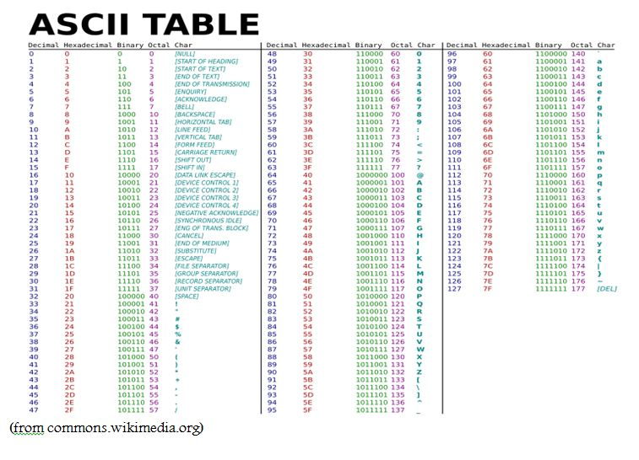

Slide 34
Signe and Unsigned Representation
Standard Number Lengths
Byte – 8 bits
Word – 16 bits
Doubleword – 32 bits
Quadword – 64 bits

Slide 35
Examples:
Give us the word length binary representation of the decimal number 335
Binary =101001111, Word-length binary= 0000000101001111
Give us the word length hex representation of the decimal number 335
hex =14F , Word-length hex= 014F
01 | 4F

Slide 36
Unsigned Representation
Just binary in one of the standard lengths
16D9 is the word-length unsigned representation for the decimal number 5849.

Slide 37
Signed Representation
Signed Magnitude
leftmost digit used as a sign indication, if it’s 0 the number is positive, if it’s 1 the number is negative.
00001010 = decimal 10
10001010 = decimal -10
2’s complement representation
Use One of tthe sandard lengths
High-order (leading) bit gives sign
0 for positive
1 for negative
for example, that the most positive number that can be represented in word-size 2’s complement form is 0111111111111111₂ or 7FFF₁₆ or 32767₁₀.
For a negative number, you must perform the 2’s complement operation to find the corresponding positive number.

Slide 38
2’s Complement Operation in Hex
+/- button on many calculators
Manually by subtracting from 100…0
Example:
E47A represents a negative word-length signed number since E = 1110
10000 – E47A = 1B86 = 7046₁₀, so E47A is the 2’s complement signed representation for –7046

Slide 39
2’s Complement Operation in Binary
The Two’s Complement of a binary number is basically another number which, when added to the original, will make all bits become zeroes.
Steps:
Find the one’s complement
add 1 to it.
Example
The binary representation of 12 is 00001100.
It’s one’s complement is 11110011.
Add one to that and we have its two’s complement.
11110011 (one's complement of 12) + 00000001 (decimal 1) = 11110100 (two's complement of 12)

Slide 40
1’s Complement Operation
1’s complement negate a number by fliping3 all its bits.
The 1’s complement of 01110000 is 10001111.
1’s complement rarely used for signed integers in modern systems

Slide 41
Addition and Subtraction

Slide 42
Binary Addition and Subtraction
Addition
The four basic rules for binary addition are
0 0 0 | 1 0 1 | 0 1 1 | 1 1 01

Slide 43
Carry
If the sum of two numbers is one bit longer than the operand size, the extra 1 is a carry (or carry out).
carry in
1 | 1 | 1 |  |  | 1 | 1
 | 1 | 1 | 1 | 0 | 0 | 1 | 1 | 1
+ | 1 | 1 | 1 | 1 | 0 | 1 | 1 | 0
1 | 1 | 1 | 0 | 1 | 1 | 1 | 0 | 1
carry out

Slide 44
Subtraction
In a computer, subtraction a − b of numbers a and b is usually performed by taking the 2’s complement of b and adding the result to a. This corresponds to adding the negation of b
There is a borrow in subtraction – when the second number is larger than the first as unsigned numbers.

Slide 45
Subtraction Example
 | 1 | 1 | 0 | 0 | 1 | 0 | 1 | 1
- | 1 | 1 | 1 | 0 | 0 | 0 | 1 | 1
 |  |  | 1 | 1 | 1 | 1 | 1
 | 1 | 1 | 0 | 0 | 1 | 0 | 1 | 1
+ | 0 | 0 | 0 | 1 | 1 | 1 | 0 | 1
 | 1 | 1 | 1 | 0 | 1 | 0 | 0 | 0

Slide 46
Multiple Interpretations
One pattern of bits can have many different interpretations.
The word FE89 can be interpreted as
An unsigned number whose decimal value is 65513
A signed number whose decimal value is –375

Slide 47
Integer Addition and Subtraction
Addition
Same for unsigned and 2’s complement signed numbers, but the results may be interpreted differently
The two numbers will be byte-size, word-size, doubleword-size, or quadword-size.
Add the bits and store the sum in the same length as the operands, discarding an extra bit (if any).
 | 0 | A | 0 | 7
+ | 0 | 1 | D | 3
 | 0 | B | D | A

Slide 48
Carry
If the sum of two numbers is one bit longer than the operand size, the extra 1 is a carry (or carry out).
A carry is discarded when storing the result, but we’ll see how the 80x86 CPU records it.
For unsigned numbers, a carry means that the result was too large to be stored – the answer is wrong.

Slide 49
Carry In
A 1 carried into the high-order (sign, leftmost) bit position during addition is called a carry in.
Byte-length example
carry in
1 | 1 | 1 |  |  | 1 | 1
 | 1 | 1 | 1 | 0 | 0 | 1 | 1 | 1 |  |  |  | E | 7
+ | 1 | 1 | 1 | 1 | 0 | 1 | 1 | 0 |  |  | + | F | 6
1 | 1 | 1 | 0 | 1 | 1 | 1 | 0 | 1 |  |  | 1 | D | D
carry out

Slide 50
Overflow
Overflow occurs when there is a carry in but no carry out, or when there is a carry out but no carry in. It recorded by the CPU.
If overflow occurs when adding two signed numbers, then the result will be incorrect.
Word-length example
Overflow, so AC99 incorrect if viewed as sum of signed numbers
No carry, so AC99 correct if viewed as sum of unsigned numbers
483F
+ 645A
AC99

Slide 51


Overflow
If there is no carry in and no carry out, or when there is a carry in but no carry out, then no overflow.

Slide 52


Overflow
Overflow occurs when there is a carry in but no carry out, or when there is a carry out but no carry in. It recorded by the CPU.
If overflow occurs when adding two signed numbers, then the result will be incorrect.

Slide 53
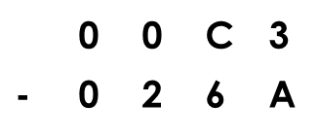

Subtraction
If we want to do the following subtraction
Take the 2’s complement of second number and add it to the first number.
CF is set for a borrow in subtraction
 | 0 | 0 | C | 3
+ | F | D | 9 | 6
 | F | E | 5 | 9

Slide 54
Overflow occurs in subtraction if it occurs in the corresponding addition.
There is a borrow in subtraction – when the second number is larger than the first as unsigned numbers. There is a borrow in subtraction when there is not a carry in the corresponding addition.

Slide 55
Other Systems For Representing Numbers

Slide 56
Binary Coded Decimal
BCD uses four bits to encode each decimal digit.
479 could be encoded in two bytes as 0000 0100 0111 1001
The Intel architecture has only a few instructions to do arithmetic on BCD numbers.

Slide 57
Floating Point
Floating point representation systems allow for nonintegers to be represented, or at least closely approximated.
IEEE single precision is a popular 32-bit format
Write the number in base 2 “scientific notation”
Sign bit (0 positive, 1 negative)
8 bits for exponent (actual exponent plus a bias of 127)
23 bits for fraction (omitting the leading 1)

Slide 58
Floating Point Example
78.375₁₀ = 1001110.011₂
78 = 1001110
.375 = .o11
In binary, the positions to the right of the binary point 2 (1/2=0.5, ¼=0.25, 1/8=o.125, etc.),

Slide 59
Convert 11.101 to Decimal
Integral Part = 11B
1*2 + 1*1 =3
Hence, 11B = 3 D
Therefore, 11.101 B = 3.625 D
Fractional Part = .101 B
=1/2 + 0/4 + 1/8
= .625 D

